Slide 1
Chapter 2:
The Project Management and Information Technology Context
Note: See the text itself for full citations.

Slide 2

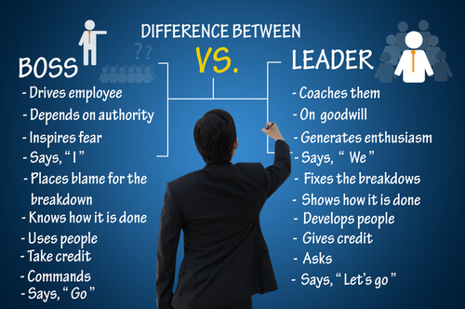
Manager - Leader

Slide 3
Projects Cannot Be Run In Isolation
Projects must operate in a broad organizational environment
Project managers need to use systems thinking within the context of the organization
Senior managers must make sure projects continue to support current business needs

Slide 4
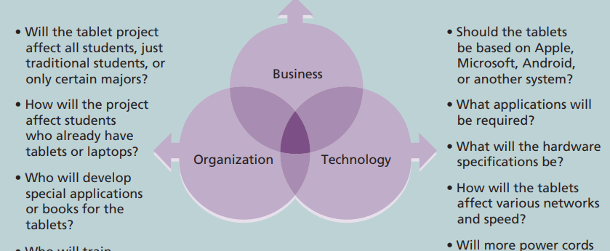
Three Sphere Model for Systems Management

Slide 5
Organizational Structures
Functional
functional managers report to the chief executive officer (CEO)
Project
program managers report to the CEO
Matrix
personnel often report to two or more bosses; structure can be weak, balanced, or strong matrix
Notes:
personnel often report to two or more bosses;

Slide 6
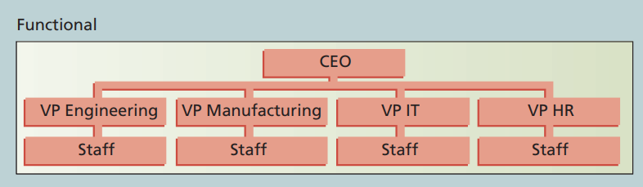
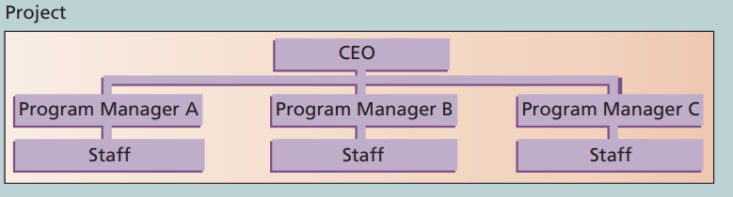
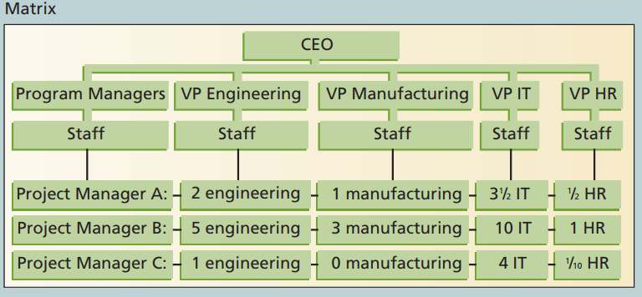
Organizational Structures
Vice President
Notes:
Vice President
chief executive officer (CEO),

Slide 7
Organizational Structure Influences on Projects
Project Characteristics | Functional | Matrix |  |  | Project
 |  | Weak Matrix | Balanced Matrix | Strong Matrix
PM Authority | Little or none | Limited | Low to Moderate | Moderate to High | High to almost total
project budget | Functional manager | Functional manager | Mixed | Project manager | Project manager
PM Role | Part-time | Part-time | Full-time | Full-time | Full-time
Common title | Project Coordinator/ Project Leader | Project Coordinator/ Project Leader | Project Manager/ Project Officer | Project Manager / Program Manager | Project Manager/ Program Manager

Slide 8
The Importance of Top Management Commitment
People in top management positions are key stakeholders in projects
A very important factor in helping project managers successfully lead projects is the level of commitment and support they receive from top management
Without top management commitment, many projects will fail.
Some projects have a senior manager called a champion who acts as a key proponent for a project.
Notes:
والذي يعمل كمؤيد رئيسي للمشروع.

Slide 9
How Top Management Can Help Project Managers
Providing adequate resources
Approving unique project needs in a timely manner
Getting cooperation from other parts of the organization
Mentoring and coaching on leadership issues

Slide 10
Project Phases and the Project Life Cycle
https://youtu.be/845Rm6pGjqY
https://youtu.be/N3N9-RLSbvo
https://youtu.be/5RocT_OdQcA

Slide 11
Project Phases and the Project Life Cycle
A project life cycle is a collection of project phases that defines
  what work will be performed in each phase
  what deliverables will be produced and when
  who is involved in each phase, and
  how management will control and approve work produced in each phase
A deliverable is a product or service produced or provided as part of a project
Notes:
Products also have life cycles
The Systems Development Life Cycle (SDLC) is a framework for describing the phases involved in developing and maintaining information systems
Systems development projects can follow
Predictive life cycle: the scope of the project can be clearly articulated and the schedule and cost can be predicted
Adaptive Software Development (ASD) life cycle: requirements cannot be clearly expressed, projects are mission driven and component based, using time-based cycles to meet target dates

Slide 12
Project Phases and the Project Life Cycle
Initiate work
What
Who
Management
How
Product
What
When

Slide 13
More on Project Phases
In early phases of a project life cycle
  resource needs are usually lowest
  the level of uncertainty (risk) is highest
  project stakeholders have the greatest opportunity to influence the project
In middle phases of a project life cycle
  the certainty of completing a project improves
  more resources are needed
The final phase of a project life cycle focuses on
  ensuring that project requirements were met
  the sponsor approves completion of the project

Slide 14
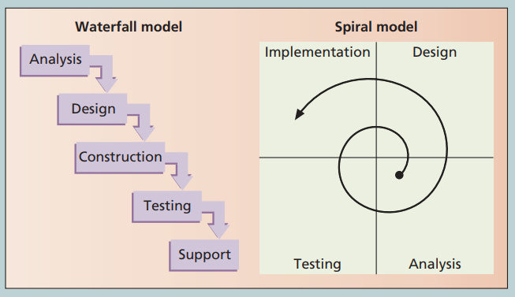
Waterfall and Spiral Life Cycle Models

Slide 15
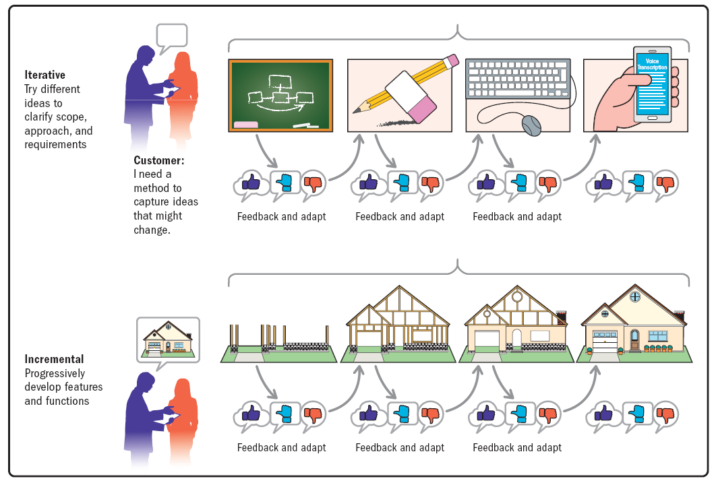

Slide 16
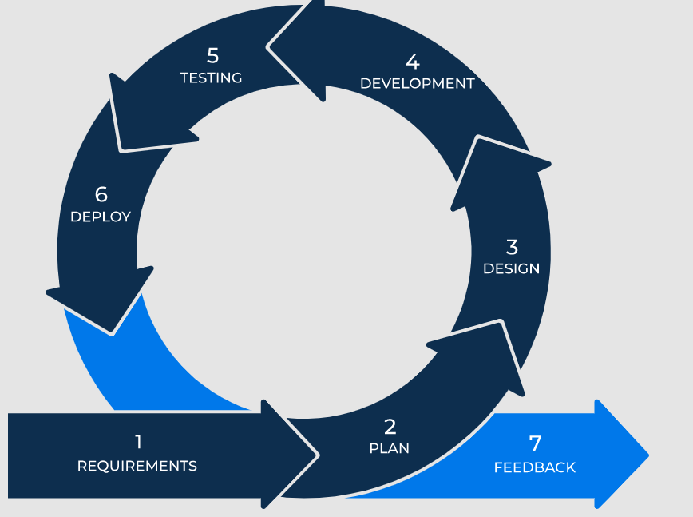
Agile Model

Slide 17
Agile Software Development
Agile software development has become popular to describe new approaches that focus on close collaboration between programming teams and business experts
Notes:
Agile means being able to move quickly and easily, but some people feel that project management, as they have seen it used, does not allow people to work quickly or easily.
Early software development projects often used a waterfall approach, as defined earlier in this chapter. As technology and businesses became more complex, the approach was often difficult to use because requirements were unknown or continuously changing.
Agile today means using a method based on iterative and incremental development, in which requirements and solutions evolve through collaboration.

Slide 18
The Importance of Project Phases and Management Reviews
A project should successfully pass through each of the project phases in order to continue on to the next
Management reviews, also called phase exits or kill points, should occur after each phase to evaluate the project’s progress, likely success, and continued compatibility with organizational goals

Slide 19
Trends Affecting IT Project Management
Recent Trends
Globalization
Outsourcing
Offshoring
Virtual teams
Agile
https://youtu.be/DjaLaUsrLKA
Notes:
Globalization: Digital revolution
Outsourcing: Outsourcing is when an organization acquires goods and/or sources from an outside source. Offshoring is sometimes used to describe outsourcing from another country
Virtual teams: A virtual team is a group of individuals who work across time and space using communication technologies
Agile project management

Slide 20
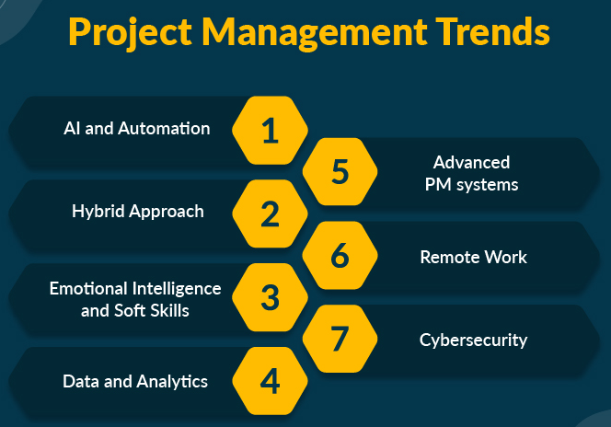

Slide 21
Chapter Summary
Project managers need to take a systems approach when working on projects
The structure and culture of an organization have strong implications for project managers
Projects should successfully pass through each phase of the project life cycle
Recent trends affecting IT project management include globalization, outsourcing, virtual teams, and Agile

Slide 22
Questions
What is project management?
Define a project and distinguish between projects and operations.
What are the key characteristics of a project?
Explain the triple constraint and its role in project management.
What is a program? What is a project portfolio? Discuss the relationship between projects, programs, and portfolio management
What is the role of the project manager? What are the suggested skills for all project managers and for IT project managers?
List the stakeholders in project management.

Slide 23
Questions
Briefly explain the differences between functional, matrix, and project organizations.
Discuss the importance of top management commitment for successful project management.
Define globalization, outsourcing, offshoring, virtual teams, and agile project management

